Slide 1

Introduction to Jenkins
Module 9: Controller/Agent Architecture

Slide 2
Topics
Static vs. ephemeral agents
SSH, inbound, and cloud agents
Docker agents and container-based builds
Kubernetes agents with Jenkins Kubernetes Plugin
Workload distribution and performance

Slide 3
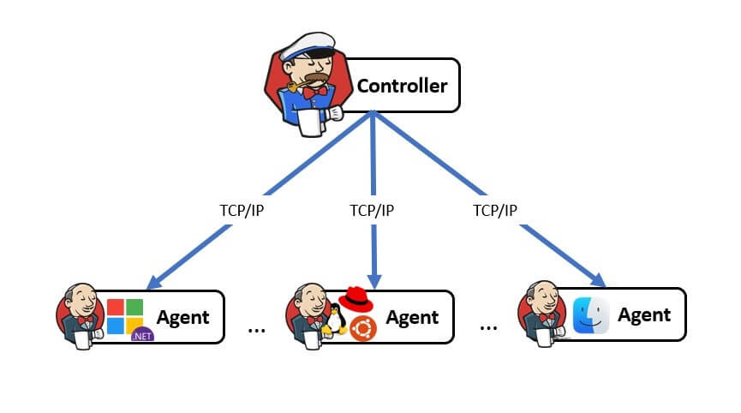
Jenkins Agents Recap
The Jenkins controller is the brain of Jenkins
  It is responsible for
    Scheduling jobs
    Managing configuration
    Storing build metadata
    Hosting the UI and REST API
    Orchestrating agents
  The controller should not be subject to workloads that might degrade the performance of these responsibilities

Slide 4
Jenkins Agents Recap
Agents are worker nodes that
  Execute pipeline steps
  Run build tools
  Compile code
  Run tests
  Perform deployments
Agents
  Connect to the controller
  Execute work
  Report results back

Slide 5
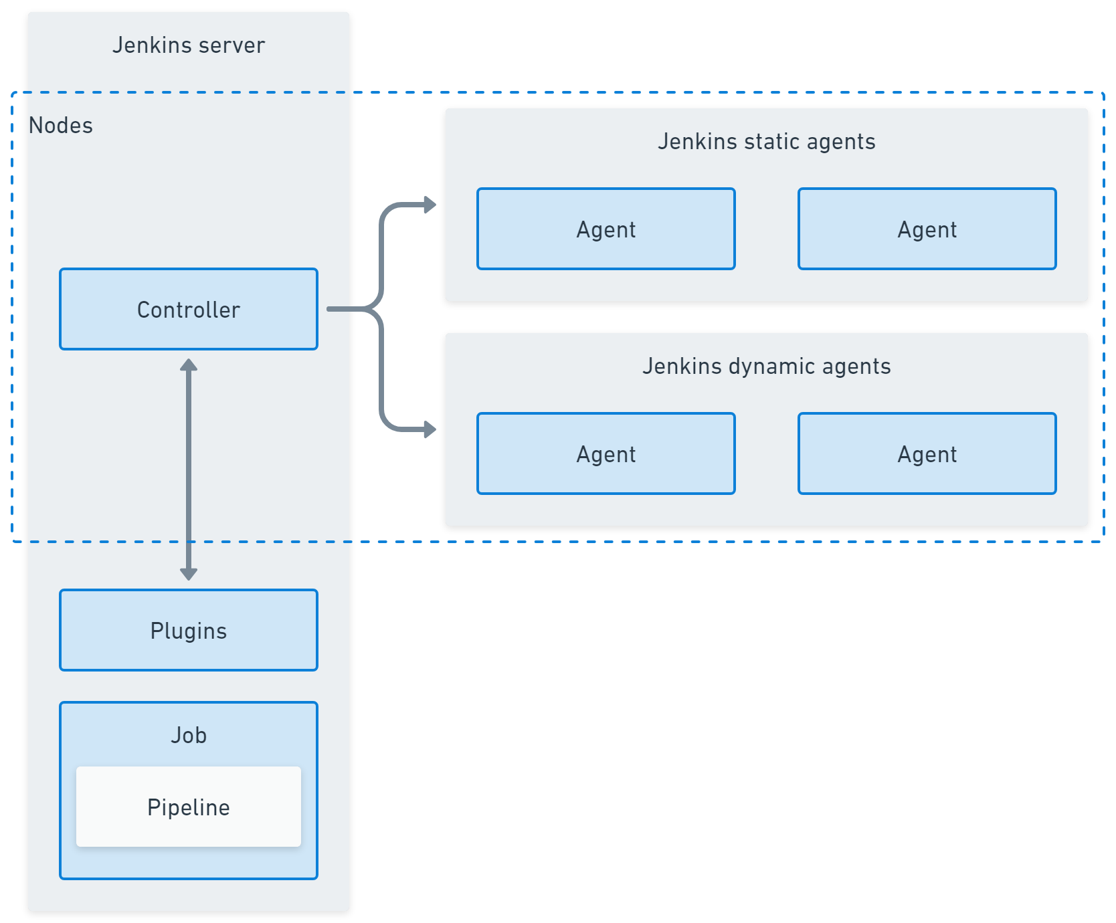
Static and Ephemeral Agents
Static agents are:
  Long-running machines
  Permanently attached to Jenkins
  Often manually provisioned
  Examples:
    A fixed Linux VM
    A Windows build server
Pros
  Simple to understand
  Predictable environment
Cons
  Tool drift over time
  Manual maintenance
  Limited scalability
Image Credit: https://octopus.com/devops/jenkins/

Slide 6
Static and Ephemeral Agents
Ephemeral agents are
  Created on demand
  Used for one build
  Destroyed afterward
  Examples:
    Docker containers
    Kubernetes pods
    Cloud-provisioned VMs
Pros
  Clean environments
  Consistent builds
  Easy scaling
Cons
  Slight startup overhead
  Requires infrastructure integration
Image Credit: https://octopus.com/devops/jenkins/

Slide 7
Static and Ephemeral Agents
Static agents use cases
  Small teams
  Low build volume
  Legacy environments
  Proof-of-concept Jenkins installs
  Regulated environments with fixed infrastructure
Image Credit: https://octopus.com/devops/jenkins/

Slide 8
Static and Ephemeral Agents
Ephemeral agents use cases
  Medium to large organizations
  Multiple teams using Jenkins
  High or bursty CI workloads
  Cloud-native environments
  Security-sensitive pipelines
  Long-term Jenkins adoption
Image Credit: https://octopus.com/devops/jenkins/

Slide 9
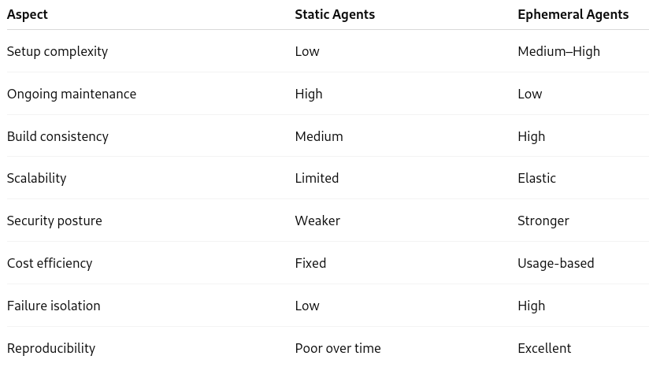
Static and Ephemeral Agents

Slide 10
SSH Agents
An SSH agent
  Runs on a remote machine
  Is accessed by the Jenkins controller over SSH
  Original Jenkins agent model, especially in Unix/Linux environments
Connection Flow
  Jenkins controller has SSH credentials
  Controller initiates an SSH connection to the agent machine
  Jenkins launches an agent process remotely
  Agent listens for work from the controller
  Build steps execute on the remote machine
  Results are sent back to the controller

Slide 11
SSH Agents
The SSH agent is a separate host
  Usually a
    Physical server
    Virtual machine
    Cloud VM
Runs its own OS and tool chain
  Protects the controller from the build environment
  Allows workload isolation
  Enables horizontal scaling

Slide 12
SSH Agents Use Cases
Existing servers
  SSH agents are ideal when an organization already has:
    Dedicated build servers
    Legacy infrastructure
    Long-running VMs
  Instead of replacing these machines Jenkins simply connects to them
  Reduces
    Migration effort
    Initial cost
    Disruption

Slide 13
SSH Agents Limitations and Risks
Configuration drift
  Because SSH agents are long-lived
    Tools get upgraded manually
    Builds change behavior over time in response to environment changes
    Reproducibility suffers
Maintenance burden
  Ops teams must
    Patch OS
    Upgrade tools
    Clean workspaces
    Rotate SSH keys
  This work grows with
    Agent count
    Team size

Slide 14
SSH Agents Limitations and Risks
Scalability constraints
  Agents are finite
  Build spikes cause queues
  Adding capacity is slow
  SSH agents do not scale automatically
Security considerations
  SSH keys must be protected
  Compromised agents pose risk
  Credentials may linger on disk
  This makes SSH agents less attractive for
    High-security environments
    Regulated workloads

Slide 15
SSH Agents
SSH agents are appropriate when
  Infrastructure is static
  Network is trusted and stable
  CI workload is predictable
  Cloud or container adoption is low
SSH agents are not ideal for
  Highly elastic CI
  Short-lived builds
  Modern cloud-native pipelines

Slide 16
Inbound Agents
An Inbound agent
  Initiates the connection to the Jenkins controller
  Connects using a secure inbound protocol
  Waits for work from the controller
  This reverses the SSH model
  The agent connects to Jenkins, not the other way around
  Also called JNLP agents
    JNLP = Java Network Launch Protocol
    Historically used by Java-based agents to connect to the controller

Slide 17
Creating Inbound Agents
An agent node is created in Jenkins which generates
  A secret
  A JNLP URL (connection info)
The agent machine runs
    java -jar agent.jar -jnlpUrl <url> -secret <secret>
  The agent initiates the connection to the controller
  Jenkins accepts it and schedules jobs on the agent

Slide 18
Inbound Agents
Connection flow
  Agent process starts on a machine
  Agent opens an outbound connection to the controller
  Controller authenticates the agent
  Agent registers and waits for work
  Build steps execute on the agent
  Results are sent back to the controller
  No inbound firewall rules are required on the agent side

Slide 19
Inbound Agents
Inbound agents connectivity
  Use outbound connections only
  Work through strict firewalls and NAT
  Avoid opening SSH ports
Ideal for
  Locked-down corporate networks
  Cloud environments with strict security controls
  Environments where inbound access is prohibited

Slide 20
Inbound Agents
Inbound agents are widely used in
  Cloud VMs
  Container-based agents
  Kubernetes pods
  Auto-scaled environments
  Cases where the agent is ephemeral
Default choice for modern Jenkins deployments

Slide 21
Inbound Agents Use Cases
Locked-down networks
  Inbound agents work where
    Agents cannot be reached directly
    Security policies forbid inbound access
    Only outbound HTTPS is allowed
  Common in
    Financial institutions
    Regulated industries
    Zero-trust networks

Slide 22
Inbound Agents Use Cases
Agents started dynamically
  Inbound agents are ideal when
    Agents start and stop automatically
    Infrastructure is short-lived
    Jenkins should not manage host access
  Examples
    Docker containers
    Kubernetes pods
    Auto-scaled cloud instances

Slide 23
Operational Advantages
Security
  No SSH keys on the controller
  Reduced attack surface
  Easier firewall configuration
Scalability
  Agents come and go
  No static registration required
Flexibility
  Works across networks and clouds

Slide 24
Operational Tradeoffs
More moving parts
  Requires agent launch logic
  Requires correct agent configuration
Harder to debug
  Connection issues can be less visible
  Logs may be distributed

Slide 25
Inbound Agents
Inbound agents are the right choice when
  Agents are ephemeral
  Networks are restrictive
  Jenkins runs in the cloud
  Kubernetes or container agents are used

Slide 26
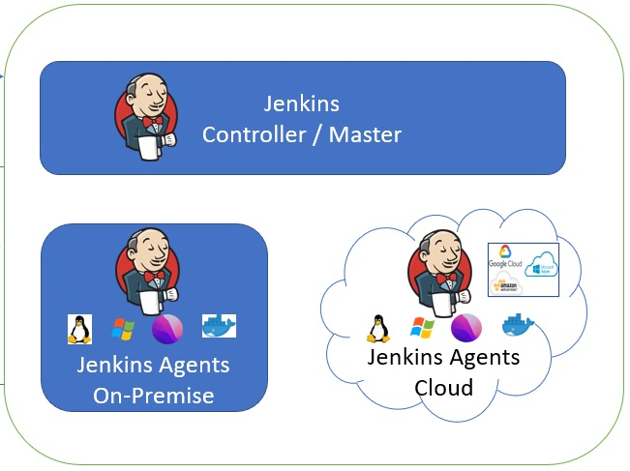
Cloud Agents
Cloud agents are
  Provisioned automatically by Jenkins
  Created only when there is work to do
  Destroyed when no longer needed
  Managed through cloud provider APIs
Allow Jenkins to scale capacity dynamically
  Rather than relying on permanently running build machines
Cloud agents turn Jenkins from a fixed capacity system into an elastic service

Slide 27
Automatically Provisioned
Jenkins does not require operators to
  Create VMs manually
  Register agents by hand
  Predict future capacity
Instead, Jenkins
  Detects demand
  Requests new agents dynamically
  Provisioning logic is configured once and reused automatically

Slide 28
Lifecycle
Cloud agents
  Are created when builds queue up
  Execute one or more builds
  Shut down when idle
Eliminates
  Idle machines
  Long-running unused agents
  Manual capacity management

Slide 29
Lifecycle
Cloud agents are typically terminated
  After a single build
  Or after an idle timeout
Guarantees
  Clean build environments
  No workspace contamination
  No lingering credentials or artifacts

Slide 30
Provisioning Flow
Typical flow
  Build queue grows
    Jenkins detects that no suitable agent is available
  Cloud plugin is triggered
    Jenkins evaluates configured cloud templates
    Determines which agent type matches the job
  Provisioning request sent
    Jenkins calls the cloud provider API
    Requests a new VM instance
  VM is created
    Image, size, network, and credentials are applied
    Startup scripts install or launch Jenkins agent software
  Agent connects to Jenkins
    Usually via inbound (JNLP) connection
    Agent registers itself dynamically
  Build executes
    Pipeline steps run on the new VM
  Idle timeout expires
    Agent is terminated automatically
    Resources are released back to the cloud

Slide 31
Cloud Provider Integration
Jenkins integrates natively with
  AWS EC2
  Azure Virtual Machines
  Google Compute Engine (GCE)
  For each cloud provider, Jenkins can define
    VM images (AMIs, images, snapshots)
    Instance sizes
    Network settings
    Labels for job placement
    Maximum instance counts
    Idle termination policies
  These definitions act as agent templates

Slide 32
Elastic Scaling
Cloud agents handle
  Sudden spikes in commits
  Parallel pipelines
  Multiple teams building at once
Instead of builds waiting in long queues
  Jenkins requests more agents
Leads to
  Faster feedback
  Higher developer productivity

Slide 33
Cost Efficiency
With cloud agents
  Costs are pay as you go, not capital investment
  Idle time is eliminated
  Resources match actual demand
Compared to static agents
  No wasted overnight or weekend capacity from idle agent machines
  Lower total cost of ownership

Slide 34
Clean, Reproducible Environments
Each cloud agent
  Starts from a known image
  Has no history from previous builds
  Eliminates configuration drift
This improves
  Build reliability
  Debugging accuracy
  Audit trails and governance capabilities

Slide 35
Operational Tradeoffs
Startup latency
  Cloud agents:
    Take time to provision
    VM startup may take minutes
  This makes them
    Slower than containers
    Unsuitable for ultra-low-latency CI
  Mitigation includes
    Warm pools
    Smaller images
    Pre-configured startup scripts

Slide 36
Operational Tradeoffs
Cloud dependency
  Cloud agents require:
    Cloud availability
    API access
    IAM permissions
  Failures can occur if
    API quotas are exceeded
    Credentials expire
    Regions are unavailable

Slide 37
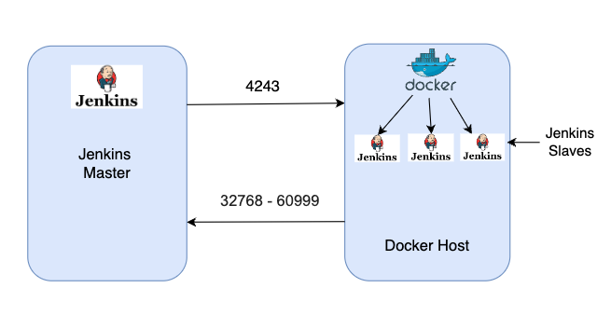
Docker Agents
A Docker agent
  Runs inside a Docker container
  Executes pipeline steps within that container
  Exists only for the duration of the build
    Ephemeral by default
  Docker is not used here primarily to build images
  But provides a controlled, repeatable runtime environment for Jenkins pipelines

Slide 38
Docker Agents Benefits
Tool version conflicts can be resolved
  On static agents
    One job needs Java 11
    Another needs Java 17
    Another needs Node 18
  This leads to
    PATH manipulation
    Fragile setups
    Frequent breakage
  Docker agents solve this by
    Encapsulating tools into images
    Running each build in its own environment

Slide 39
Docker Agents Benefits
No dirty workspaces
  Long-lived agents accumulate
    Temporary files
    Cached dependencies
    Leftover artifacts
    Broken state from failed builds
  Docker agents
    Start from a clean file system
    End with container deletion
    No cleanup scripts required.

Slide 40
Docker Agents Benefits
Fast provisioning compared to VMs
  Docker containers
    Start in seconds
    Are lighter than virtual machines
    Share the host kernel
  This makes Docker agents
    Faster than cloud VM agents
    Ideal for short-lived CI tasks

Slide 41
Docker Agent Lifecycle
Control flow
  Pipeline requests a Docker agent
    Based on Jenkinsfile definition
  Jenkins pulls the container image
    From a registry (Docker Hub, ECR, etc.)
    Cached images start faster
  Container is started
    Workspace is mounted
    Environment variables are injected
    Credentials are provided securely
  Pipeline steps execute
    sh, build tools, tests run inside container
  Container stops
    Workspace may persist (depending on configuration)
    Container is destroyed

Slide 42
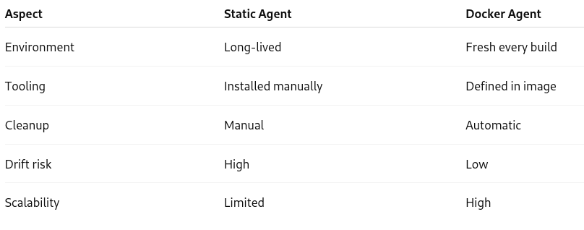
Docker Agents vs Static Agents

Slide 43
Limitations and Tradeoffs
Requires Docker infrastructure
  Docker agents need
    Docker installed
    Proper daemon access
    Secure host configuration
Not fully isolated like VMs
  Containers
    Share the host kernel
    Are not full virtual machines
  For high-security workloads
    Additional hardening may be required
    Kubernetes or VM isolation may be preferred

Slide 44
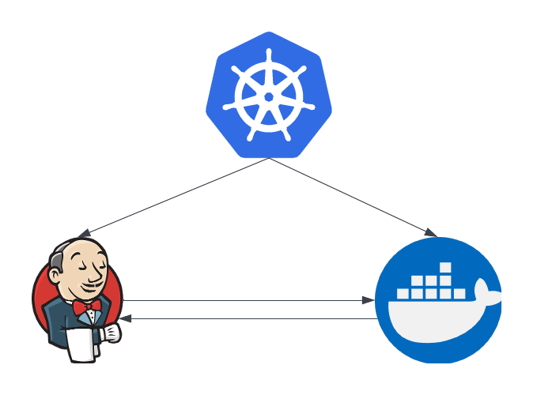
Kubernetes Agents
Jenkins uses Kubernetes pods as build agents
  Instead of
    Long-lived machines
    Pre-registered agents
  Jenkins dynamically creates short-lived pods to execute builds
  Each pod acts as a Jenkins agent
  Exists only for the duration of the build
  Is destroyed afterward

Slide 45
Agent as a Pod
In this model:
  One Jenkins agent = one Kubernetes pod
  The pod contains
    A Jenkins agent container
    One or more tool containers
  The pod has
    Its own resources and memory limits
    Its own filesystem
    Its own lifecycle
  This eliminates
    Agent reuse
    Configuration drift
    Manual cleanup

Slide 46
Kubernetes Benefits
Automatic scaling
  Kubernetes
    Schedules pods automatically
    Scales with demand
    Manages node capacity
  Jenkins benefits because
    Agents appear only when builds need them
    No fixed upper limit (within cluster capacity)
    CI scales naturally with developer activity

Slide 47
Kubernetes Benefits
Resource isolation
  Each Kubernetes pod
    Has defined CPU and memory limits
    Cannot consume resources beyond its allocation
    Is isolated from other builds
  This prevents
    One build starving others
    Unpredictable performance
    Noisy-neighbor problems

Slide 48
Kubernetes Benefits
Self-healing
  Kubernetes
    Restarts failed pods
    Reschedules pods if nodes fail
    Handles infrastructure failures transparently
  For Jenkins
    Failed agent nodes don’t take down CI
    Builds fail fast instead of hanging
    Platform resilience improves dramatically

Slide 49
Kubernetes Agent Lifecycle
Agent flow
  Pipeline starts
    Jenkins evaluates agent requirements
  Jenkins requests an agent
    Via the Kubernetes plugin
    Defines pod template (containers, resources)
  Kubernetes schedules the pod
    Selects a node
    Pulls required images
  Agent container connects to Jenkins
    Usually via inbound (JNLP) connection
    Registers dynamically
  Build executes inside the pod
    Steps run in one or more containers
    Workspace is shared
  Build completes
    Pod is terminated
    All resources are released

Slide 50
Multi-Container Pods
A Kubernetes pod can contain
  Multiple containers running side-by-side
  Same pod containers share
    Filesystem (workspace)
    Network
    Lifecycle
Instead of
  Installing all tools in one Docker image
  Creating massive “everything” images
Jenkins can
  Use small, purpose-built containers
  Combine them at runtime in a single pod

Slide 51
Multi-Container Patterns
Build + Test
  Container 1: build tools (e.g. Maven)
  Container 2: test runtime
Build + Security Scan
  Container 1: compiler/build
  Container 2: security scanner
  Container 3: reporting tool
Build + Docker
  Container 1: build environment
  Container 2: Docker daemon (sidecar)
All containers
  Share the same workspace
  Are destroyed together

Slide 52
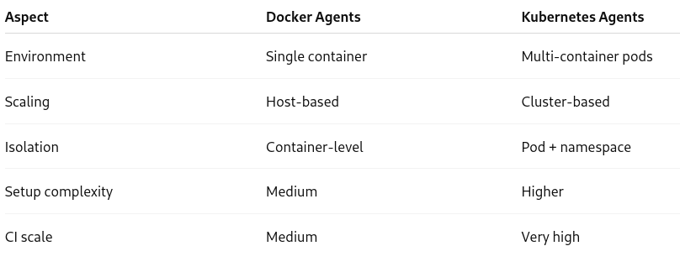
Comparison

Slide 53
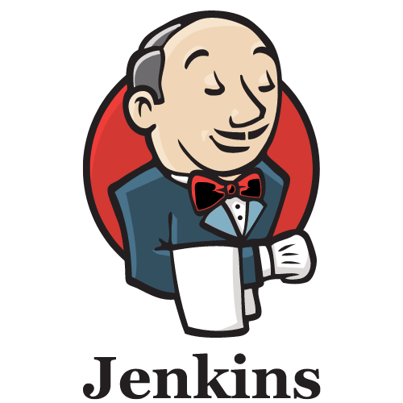
Jenkins Workload
Jenkins is a scheduler
  Its primary job is to
    Accept work (builds)
    Decide where that work should run
    Ensure work runs safely and efficiently
The build queue
  When a job is triggered
    It does not immediately start
    It is placed into the Jenkins build queue
  A job stays in the queue until
    A suitable agent is available
    An executor on that agent is free

Slide 54
Jenkins Workload
Why jobs stay queued
  No agents are available
  Agents exist but lack required labels
  All executors are busy
  Resource limits are reached
The queue contains diagnostic information explaining why a job is waiting

Slide 55
Executors
An executor is a logical slot for running a build
  Executors are not CPUs
  Executors are not threads
  They represent concurrent build capacity
    A combination of factors like thread and CPU capability
Too many executors on one agent
  Causes CPU contention
  Increases memory pressure
  Slows all builds
  Makes failures harder to diagnose

Slide 56
Performance Considerations
Number of executors
  Key tradeoff
    Too few: idle agents, long queues
    Too many: resource contention
  Rule of thumb
    Prefer one executor per agent to avoid resource contention
    Scale with more agents, not more executors
Agent availability
  If agents are
    Offline
    Misconfigured
    Slow to start
  Then
    Queue grows
    Feedback slows
    Developer productivity drops
  This is why ephemeral and cloud agents are so powerful

Slide 57
Performance Considerations
Build Duration
  Long-running builds
    Block executors
    Reduce throughput
    Increase queue time
  Common causes
    Monolithic pipelines
    Unbounded test suites
    Slow external dependencies
  Mitigations
    Break pipelines into stages
    Parallelized work
    Split tests

Slide 58
Performance Considerations
Resource Limits
  Agents must have
    Enough CPU
    Enough memory
    Adequate disk
  If resources are under-sized
    Builds slow down
    Fail intermittently
    Cause noisy-neighbor effects
  If over-sized
    Resources are wasted

Slide 59
Best Practices for Performance
Minimize executors on the controller
  Set controller executors to zero
    Jenkins controller does not use an executor to run its scheduling tasks
    Prevents accidental workload execution
    Protects Jenkins stability

Slide 60
Best Practices for Performance
Prefer ephemeral agents
  Ephemeral agents
    Start clean
    Avoid drift
    Scale automatically
    Fail fast and visibly
  This improves
    Reliability
    Throughput
    Security

Slide 61
Best Practices for Performance
Right-size agent resources
  Avoid
    One “mega-agent” doing everything
  Use smaller, purpose-built separate agents for
    Build
    Test
    Scan
Avoid long-running builds
  Best practices
    Enforce timeouts
    Fail fast
    Split pipelines
    Parallelized aggressively

Slide 62
Scaling Strategies
Add more agents (horizontal scaling)
Use ephemeral or cloud agents
Parallelized pipelines
Common performance anti-patterns
  Running builds on the controller
  Increasing executors instead of agents
  Overloading single agents
  Ignoring queue metrics
  Treating Jenkins like a single server

Slide 63
Performance Tips
To manage performance, teams should monitor
  Queue length
  Queue wait time
  Agent utilization
  Build duration trends
  Failure rates
These metrics guide
  Capacity planning
  Agent sizing
  Pipeline optimization

Slide 64
Questions

